Slide 1

^{STUDENT NAME:S.SATHISH} ^{REGISTER NO:222403563} NM ID:5041F4290D3774A8BDD48C0C24D9819B DEPARTMENT:BSC COMPUTER SCIENCE COLLEGE/UNIVERSITY:SRI DEVI ARTS AND SCIENCE COLLEGE-PONNERI/MADRAS UNIVERSITY
Digital portfolio

Slide 2
PROJECT NAME
Movie ticket booking

Slide 3
AGENDA
problem statement project Overview End users Tools and technologies Portfolio design and layout Features and functionality Results and Screenshots .Conclusion
GitHub link

Slide 4
PROBLEM STATEMENT
Design and implement a Movie Ticket Booking System using HTML, CSS, and JavaScript that allows users to select a movie, choose available seats, view the total cost, and confirm their booking interactively.

Slide 5
PROJECT OVERVIEW
Overview
This project is a simple web-based movie ticket booking system developed using HTML, CSS, and JavaScript. It allows users to:
Select a movie from a list.
Choose available seats (while occupied ones are disabled).
See the number of selected seats and total cost in real-time.
Confirm booking with a single click.

Slide 6
WHO ARE THE END USER?
End Users:The end users of this project are moviegoers/customers who want to book their seats online and cinema staff/admins who can manage seat availability

Slide 7
TOOLS AND TECHNIQUES
HTML → Structure of the web pageCSS → Styling and layout designJavaScript → Seat selection, price calculation, and booking logic

Slide 8
PORTFOLIO DESIGN AND LAYOUT
Portfolio Design and Layout: A clean and simple portfolio design with: Header section (name/title). About section (brief introduction). Projects section (showcasing works like Movie Ticket Booking). Skills section (tools & technologies). Contact section (email, links).

Slide 9
FEATURES AND FUNCTIONALITY
Features and Functionality:
Select a movie with ticket price.
Choose seats from the layout.
Highlight available, selected, and occupied seats.
Show real-time seat count and total cost.
Confirm booking with a button click. ✅

Slide 10
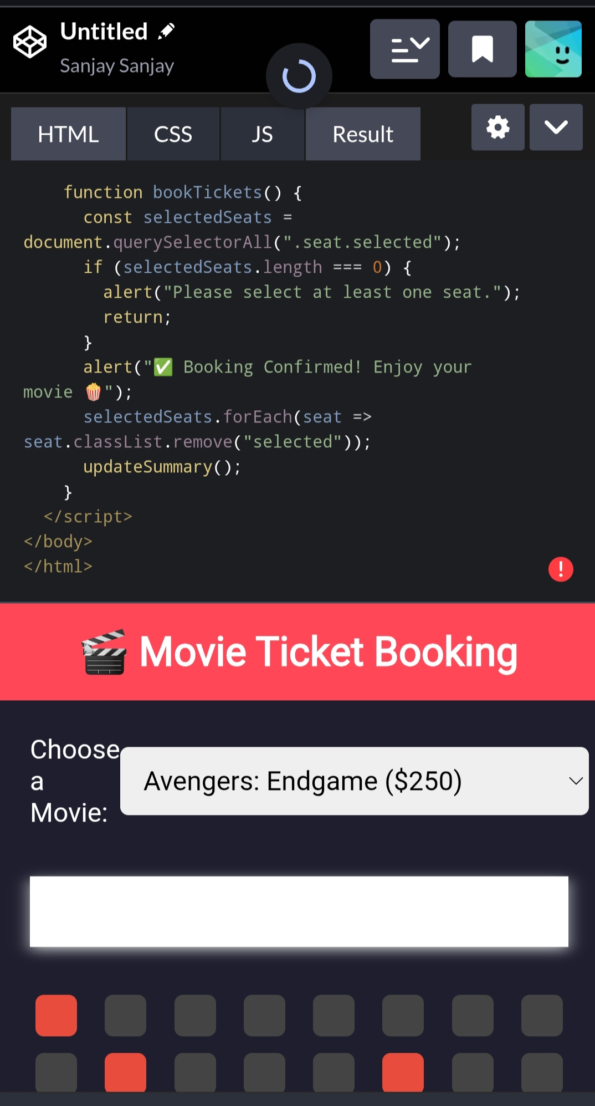
RESULTS AND SCREENSHORT
Results
The project allows users to select a movie, choose seats, and book tickets
It dynamically updates the total cost and number of seats selected.
Random seats are marked as occupied, making it realistic.
A confirmation alert appears when booking is successful
Screenshot (example)
Homepage with header and movie dropdown.
2. Seats with selected and occupied states.
3. Booking confirmation popup.

Slide 11
CONCLUSION
Conclusion: The Movie Ticket Booking System provides a simple, user-friendly, and interactive platform for selecting movies, choosing seats, and confirming bookings. It demonstrates the effective use of HTML, CSS, and JavaScript to create a practical mini-project, and it can be further enhanced by adding database connectivity and payment integration for real-world use. ✅

Slide 12
GITHUB LINK
https://ssathishbsccs24110-blip.github.io/s-sathish/

